Slide 1
CSE 4109: Artificial Intelligence
M.M.A. Hashem, PhD
Professor,
Dept. of Computer Science and Engineering
Khulna University of Engineering & Technology (KUET)
Khulna 9203, Bangladesh
Email; hashem@cse.kuet.ac.bd
Cell Phone: +880 1714 003949

Slide 2
CSE 4109: Artificial Intelligence
Introduction to Fuzzy Logic and Fuzzy Systems

Slide 3
Objectives
What Is Fuzzy Logic?
Fuzzy sets
Membership function
Differences between Fuzzy and Probability?
Fuzzy Inference.
Why Fuzzy Logic?

Slide 4
What Is Fuzzy Logic?
Theory of fuzzy sets
  Membership is a matter of degree.
  Fuzzy sets VS classical set theory.
Basic foundations of fuzzy sets
  Fuzzy sets (Zadeh, 1965) , Fuzzy Logic (Zadeh, 1973)
Fuzzy
  Reflect how people think
  Attempts to model our sense of words decision making, and common sense.
  Mathematical principles for knowledge representation based on degrees of membership rather than on crisp membership of classical binary logic.

Slide 5
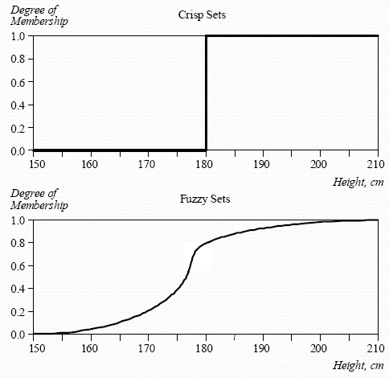
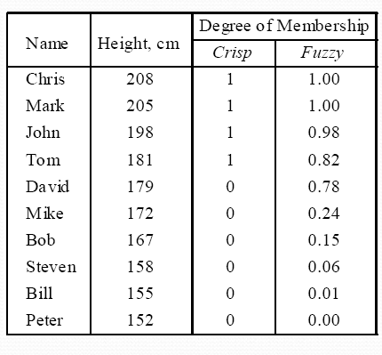
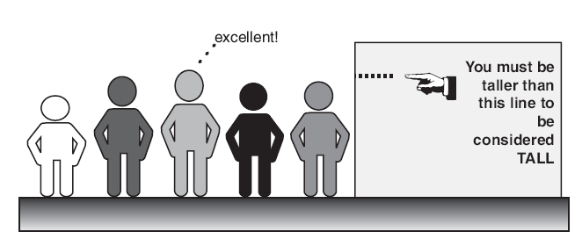
Fuzzy sets
Accept that things can be partly true and partly false to any degree at the same time.
Crisp and fuzzy sets of ‘tall men’

Slide 6
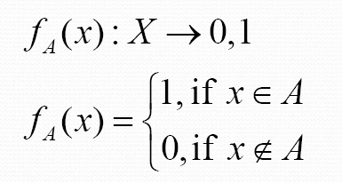
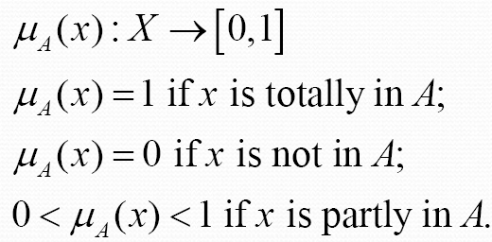
Membership function
Crisp set representation
  Characteristic function
Fuzzy set representation
  Membership function

Slide 7
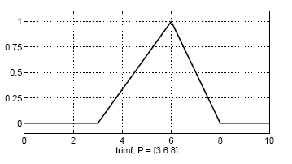
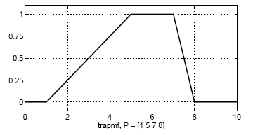
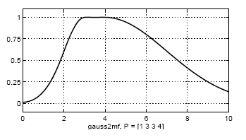
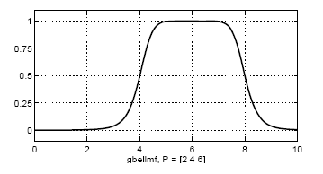
Well known Membership Functions
Triangular
Trapezoidal
Gaussian
Bell

Slide 8
Fuzzy Vs Probability
Fuzzy ≠ Probability => μ_{A}(x) ≠ p_{A}(x)
Both map x to a value in [0,1].
P_{A}(x) measures our knowledge or ignorance of the truth of the event that x belongs to the set A.
  Probability deals with uncertainty and likelihood.
μA(x) measures the degree of belongingness of x to set A and there is no interest regarding the uncertainty behind the outcome of the event x. Event x has occurred and we are interested in only making observations regarding the degree to which x belongs to A.
  Fuzzy logic deals with ambiguity and vagueness.

Slide 9
Example
A bottle of water
50% probability of being poisonous means 50% chance.
  50% water is clean.
  50% water is poisonous.
50% fuzzy membership of poisonous means that the water has poison.
  Water is half poisonous.

Slide 10
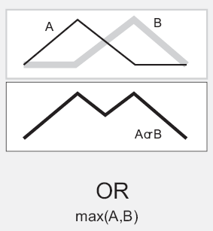
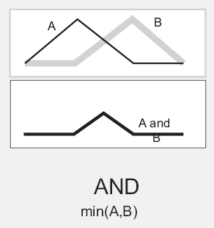
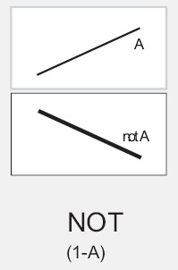
Fuzzy Logic Operations
Fuzzy union operation or fuzzy OR
  μ_{A+B}= max[μ_{A}(x), μ_{B}(x)]
Fuzzy intersection operation or fuzzy And
    μ_{A.B}= min[μ_{A}(x), μ_{B}(x)]
Complement operation
    μ_{A}= 1-μ_{A}(x)

Slide 11
Linguistic variables and hedges
Wind is a little strong.
Weather is quite cold.
Height is almost tall.
Weight is very high.
Wind, Weather, Height and Weight are linguistic variables.
A little, Quite, Almost, Very are hedges.
Strong, Cold, Tall and high are linguistic value.

Slide 12
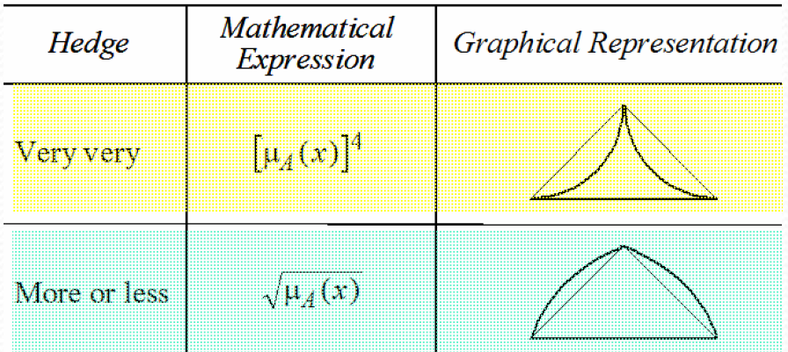
Example
Membership of body fitness

Slide 13
Fuzzy Inference
Fuzzy inference is the process of formulating the mapping from a given input to an output using fuzzy logic.
If then rules
  if temperature is cold then hot water valve is open and cold water valve is shut
Rule Base
  If the distance to intersection (dti) is far and the speed slow apply gentle breaks
  If dti is near and the speed slow apply medium breaks
  If dti is far and speed fast apply medium breaks
  If dti is near and speed fast apply high breaks

Slide 14
Fuzzy Inference
Assume we want to evaluate the health of a person based on his height and weight.
The input variables are the crisp numbers of the person’s height and weight.
Output is percentage of healthiness.

Slide 15
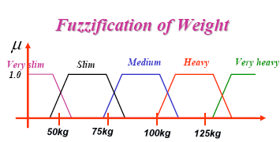
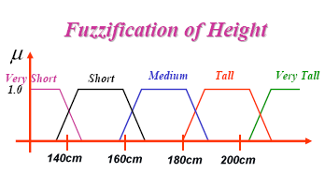
Step 1:Fuzzification
Fuzzification is a process by which the numbers are changes into linguistic words.

Slide 16
Step 2: Rules
Rules reflect experts decisions.
Rules are tabulated as fuzzy words
Rules can be grouped in subsets
Rules can be redundant
Rules can be adjusted to match desired

Slide 17
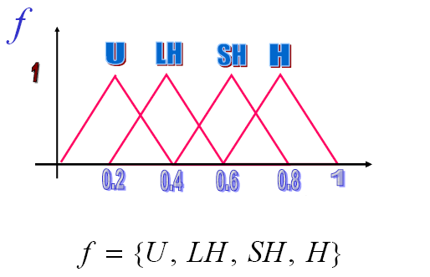
Rules(Cont.)
Rules are tabulated as fuzzy words
  – Healthy (H)
  – Somewhat healthy (SH)
  – Less Healthy (LH)
  – Unhealthy (U)
  Rule function f
f = {U, LH, SH, H}

Slide 18
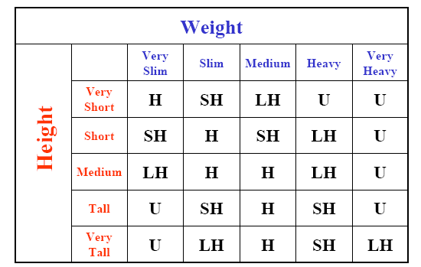
Fuzzy Rule Table

Slide 19
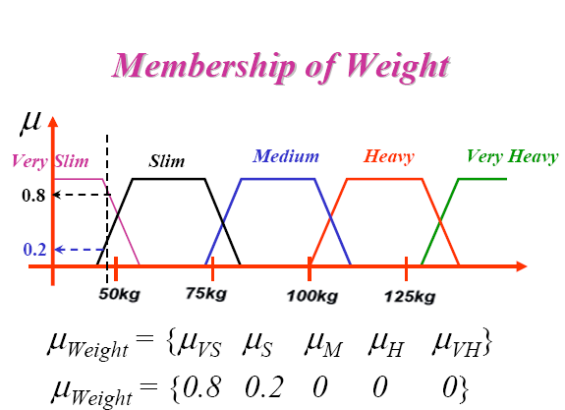
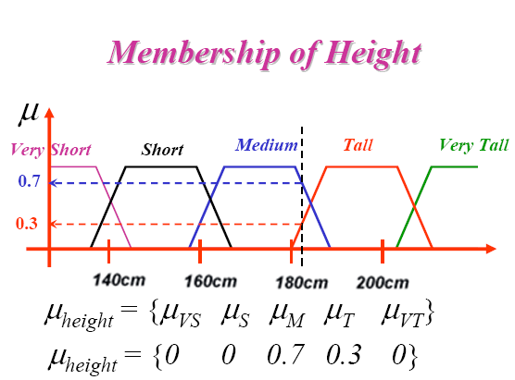
Step 3:Calculation
For a given person, compute the membership of his/her weight and height
Assume that a person height is 185cm
Assume that the person’s weight is 49

Slide 20
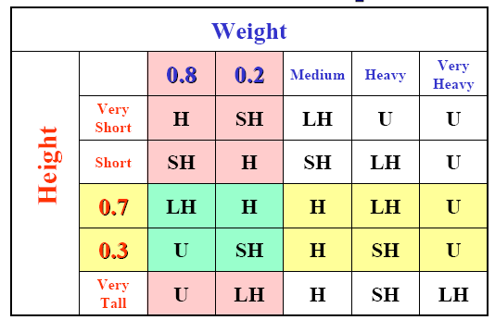
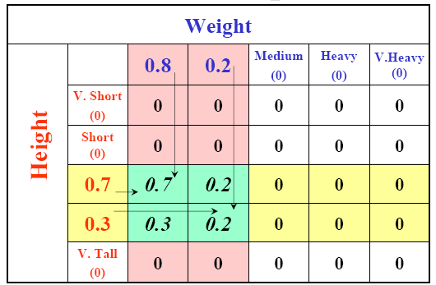
Calculation(cont.)
Rule Activation
Min Operation

Slide 21
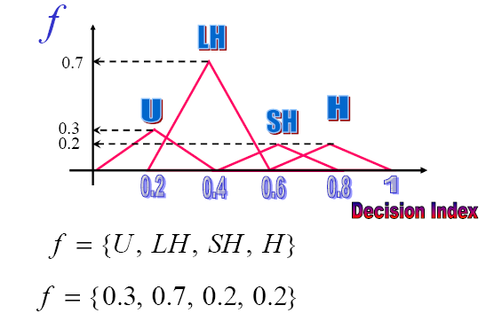
Calculation(cont.)
Scaled Fuzzified Decision

Slide 22
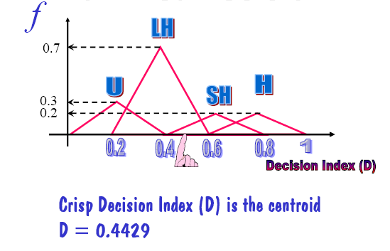
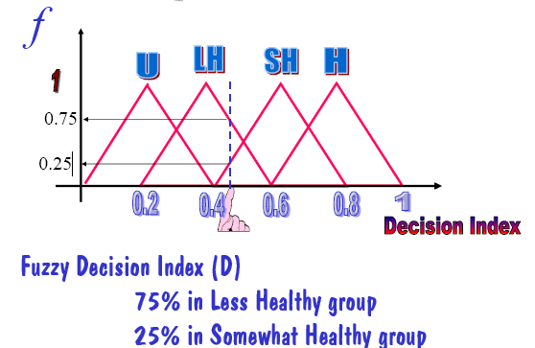
Step 4: Final Decision
Defuzzification

Slide 23
Why Fuzzy Logic?
Fuzzy logic is conceptually easy to understand.
Fuzzy logic is flexible.
Fuzzy logic is tolerant of imprecise data.
Fuzzy logic can model nonlinear functions of arbitrary complexity.
Fuzzy logic can be built on top of the experience of experts.
Fuzzy logic is based on natural language.
Fuzzy logic can be blended with conventional control techniques.

Slide 24
The End of the Lecture

